Slide 1
DevOps for Pandemics
DevOps Enterprises Summit (DOES)
October 2021

Slide 2
DevOps for Pandemics
Introduction
DevOps Principles at the Core of Pandemic Response
Responding to Crisis
Where do we go from here?
Notes:
COVID-19 has transformed the way we live and work. Today we sit amid a pandemic whose effects will extend well beyond today and into the future of work. This is truly an unprecedented event and it has forced us to adapt in ways that we could not have anticipated. Key DevOps principles and practices such as collaboration, transparency, and automation stand at the core of our ability to adapt.
Introduction
Myself & Wiley
Impact of COVID 19 here at Wiley
DevOps Principles at the Core of Crisis Response
People
Process
Technology
Responding to Crisis – example of one of our applications, the impact we saw from Covid-19, and how we were able to respond
Next Steps

Slide 3
Intro
Notes:
Let’s get started

Slide 4

Introduction
Sean D. Mack
CIO & CISO Wiley
@SeanDMackNYC
/in/SeanDMack
Notes:
I don’t want to spend a lot of time on myself or Wiley but did want to introduce myself
CIO and CISO at Wiley
Led global teams across a wide range of companies from large financial companies like Experian to innovative tech companies
Prior to Wiley I ran a global DevOps company that helped other companies drive DevOps transformation

Slide 5
| Introduction
80% of Revenue is Digital
500+ Nobel Laureates published
Wiley – A History of Transformation
Wiley has been a valued source of information for 212 years. Wiley’s content, products, and services help researchers, professionals, educators, and students around the world meet their needs and fulfill their aspirations. Wiley has 80 offices and facilities in 30 countries, with customers in over 200 countries.
Notes:
Wiley is primarily known as a publishing company but, now more than ever, we are a tech enabled research and education company.
Wiley’s success has long been defined by our ability to listen to the world and to adapt in response. Today, we are faced with global crises – the pandemic and a divided country battling with social injustice and inequality. Against this backdrop, what Wiley does – research and education – is more important than ever. And for Wiley, the only path forward, as always, is to keep evolving in pursuit of our mission to help the world heal, recover, rebuild and thrive.
We’ve been on a journey of transformation together since well before COVID-19. I’ve been with Wiley just over a year. When I started, prior to COVID, our CEO, Brian Napack, said “We are not in a single market that is not going through major disruption” and he’s right. Everything from research, to education, to publishing. And those changes are only accelerated by the crisis we face today.
Wiley is a company that has been around for over 200 years and we have only been around that long because of our ability to continue to transform. The fact that nearly 80% of Wiley's revenue is generated from digital products and tech-enabled services, and this continues to rise, is a testament to the transformation from staid publisher to digital disruptor.

Slide 6
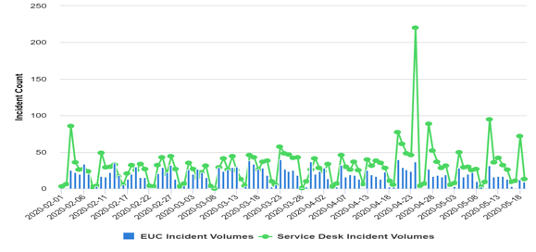
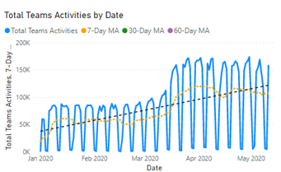
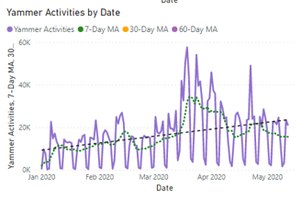
Impact of COVID19 @ Wiley
Spike in support requests
Increase in connectivity requirements
Increase in demand for collaboration tools
Increase in cybersecurity threat vectors
Increase in phishing and spearfishing
Notes:
March 13 we left the office thinking we would be at work on Monday and on March 14 we decided we would not
What we saw at Wiley was that the provisions we had put in place to enable hundreds of remote workers combined with planning around redundancy and resilience enabled us to scale to thousands
We shifted resources to staff up our Service Desk and to provide additional security
We allocated additional bandwidth
We saw applications automatically scale to meet demand and, where they did not, we were able to rapidly push changes to improve performance to our customers
Ultimately we were able to move 9000 employees to WFH in a matter of days with almost no impact
Not only that – but this crisis opened up an opportunity for acceleration on multiple fronts
This amazing response was only possible because of the underlying DevOps principles

Slide 7
DevOps Principles at the Core of Pandemic Response

Slide 8
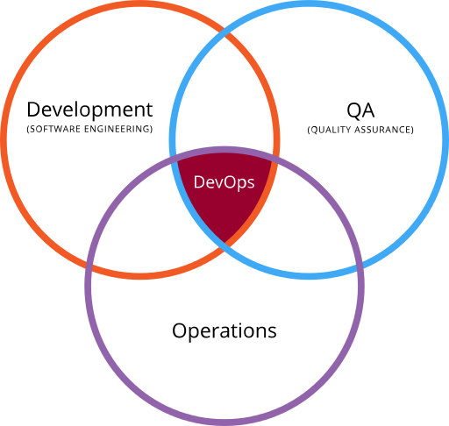
Notes:
Not gunna spend a lot of time on DevOps but I want to say that, at it’s core it is about collaboration
DevOps has evolved over the past ten years as a set of principles to respond more quickly to the rapidly changing business and technology landscape.
DevOps has transformed the way we work by bridging the gap between development and operations teams and improving time to market while improving service availability.
From the perspective of collaboration, the amazing thing about DevOps, and one of the reasons I am so passionate about it, is that it shows that, by working together better, we can improve time to market AND build more resilient system
DevOps is not tech – it is a set of principles for delivering value to the customer focused on collaboration and small batch sizes and those principles impact people, process, and tech
The same DevOps principles which have helped deliver better market outcomes have also helped us to adapt to rapidly changing conditions brought about by the COVID-19 pandemic.
The people, processes, and technologies which deliver on the principles of DevOps are all critical to success during this global crisis. – so let’s get into those
______________________________
While DevOps covers many different things, at its core it is about collaboration and collaboration has never been more critical to success than at times of crisis and rapid change. Other cultural aspects of DevOps such as a learning culture and individual empowerment also critical to success during a rapidly changing environment. The processes which surround DevOps practices are key to enabling rapid change. Key process focuses on automation and continuous learning ensure organizations can adapt to these changing times. And, of course, the technology of DevOps is key to enabling organizations to rapidly pivot. Whether it is CI/CD enabling rapid product changes, loosely coupled architecture allowing scalability, or the many collaborating tools we use to enable remote teamwork: the people, processes, and technologies of DevOps helps companies respond to major changes like the COVD-19 pandemic.
______________________
First of all DevOps is not a title/job/profession, DevOps is a culture – a healthy culture of organization's Dev and Ops guys to cooperate with each other.
DevOps is talking about many aspects of Development and Operations processes while trying to optimize the engineering organization for growth and infrastructure for scale.
DevOps is an approach to culture, automation, and platform design intended to deliver increased business value and responsiveness through rapid, high-quality service delivery. If you want to ship code faster, you need to remove all the barriers from your development process that slows it down. Create a culture of self-service and let your development team own their apps.
The goal of DevOps is not “NoOps”. That doesn’t mean that nobody is doing operations stuff. It means that the product team is doing all of it for their apps and environment. It means they are self-sufficient and take ownership. The engineers are pushing code and are on call. Operations only assist if needed, instead of development only assisting if needed.
DevOps is about "Ops who think like devs. Devs who think like ops."
DevOps is more than just automating the deployment pipeline. DevOps is everything that relates to deploying and monitoring your applications and environments.

Slide 9

People – Collaborating with a socially distanced workforce.
Notes:
People are at the center of DevOps and never have people and collaboration been more important than now.

Slide 10
DevOps People
Collaboration!
Transparency
Empowering engineers
Learning culture
Ownership and accountability
Notes:
In times of crisis and when tackling difficult tasks, good teamwork and tight collaboration are what set successful teams apart.
Trust and empowerment of the individual are core principles of DevOps.
These same principles are also critical to success in a remote work environment.
In a decentralized, work from home environment, it is not possible to maintain tight control in a bureaucratic or micro-managed environment.
Teams with a trust-based culture where individuals are empowered to act are ideally suited to thrive in a work from home environment.

Slide 11
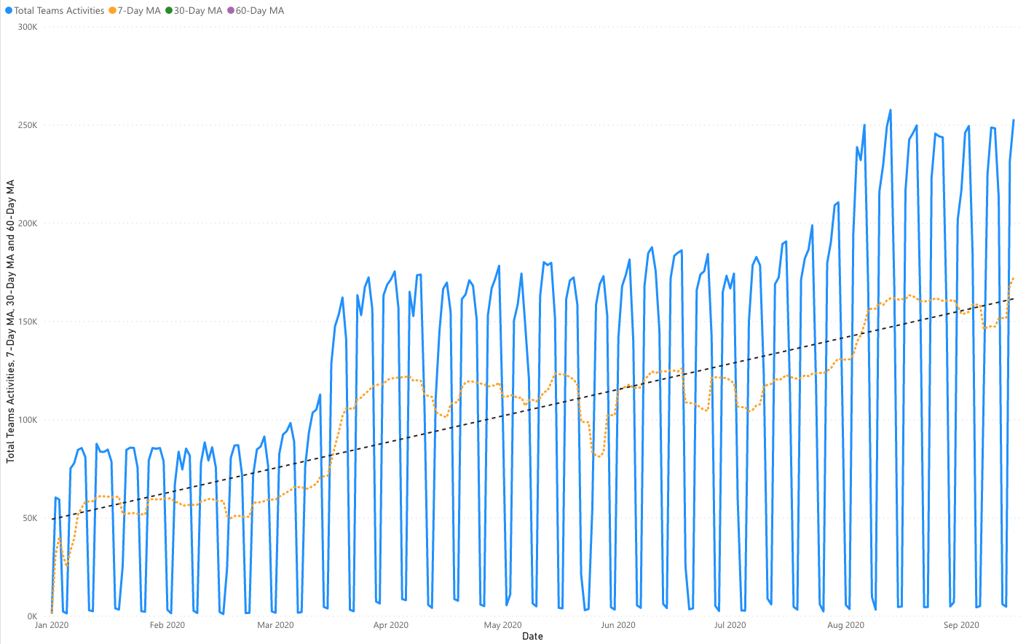
Teams YTD Activity
55% increase of average daily activity after work from home
Friday, 7/31/20
Wiley moves 100% to Teams
Monday, 3/16/20
Wiley begins work from home on global scale.
Notes:
As remote collaboration between people becomes ever more critical, so too do the tools that enable this collaboration. We must be able to socially distance our workforce to ensure that nothing we do requires that people go into the office.
Teams is our chat platform and we saw a dramatic increase when we shifted to work from home
We saw an increase of 55% after we moved to remote work
Great example of both the immediate acceleration and opportunity for more because we went beyond that initial increase and used this as an opportunity to deprecate Skype to get everyone on the same chat communications platform

Slide 12

Continuous Learning
A learning culture central to DevOps and becomes increasingly critical in the response to crisis.
Notes:
A learning culture is another element central to DevOps which becomes increasingly critical in the response to crisis.
At Wiley we are focused on education both for our customers and for our employees.
The pandemic forced us to learn new things at a rapid pace. From new tools to how to respond to new security threats.
At Wiley, we rolled out a massive training effort on our collaboration tools, running 12 training sessions in the two weeks that followed our decision to work from home where we trained more than 2,700 attendees.
We also rolled out new security training to respond to increasing cybersecurity threats related to the pandemic.
The US saw a massive increase in phishing and spear-phishing attacks in the weeks following the COVID outbreak. While we have many security tools in place, one of the most important tools is training. In response to the increase in attacks, we launched a massive training campaign. We also initiated regular, company-wide communications through our social networks to ensure that all employees were part of the security solution.
This ability of a company to learn and adapt are core tenants of DevOps, which are critical to being able to respond to COVID-19 or any crisis which disrupts the way we work.

Slide 13
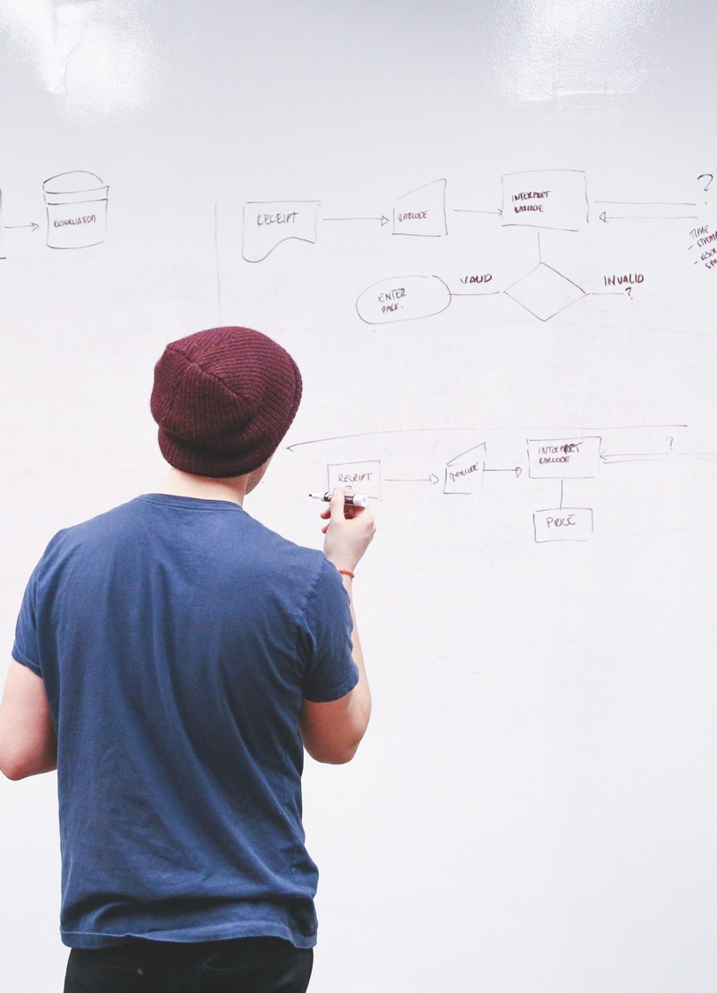
Process
Notes:
I know that some may feel that ‘DevOps’ and ‘process’ are antithetical, but this is not the case at all, instead, DevOps revolves around processes that are lightweight and automated wherever possible.
Jayne Groll – CEO of DOI said something very interesting to me one day and that is that there are no processes which are intrinsic to DevOps.
For me, what that means is that DevOps takes process from other practices, be it Agile, or ITSM, and modifies it based on DevOps principles.

Slide 14
DevOps for Process
Light weight
Automated
Trustful
Measured
Notes:
DevOps processes are automated often replacing manual process actions with activities that occur automatically.
An excellent example of this would be auto-scaling groups in cloud deployment which allow for rapid expansion to meet changes in capacity.
Rather than an extensive manual process of submitting requests for compute resources and waiting through multiple rounds of approvals systems can expand automatically to meet demand.
Another example are our light-weight change control processes which allow for automated changes to be pushed without extensive manual oversight. This does not mean we have no change control only that we enable small changes to be pushed automatically with review and approval built into the development and CI/CD pipeline
These sorts of automated and trustful processes were critical to Wiley’s COVID-19 response where we saw significant spikes in demand for our online education products as millions of students moved to online learning.

Slide 15

Technology
Notes:
DevOps technologies such as CI/CD and monitoring all help get to market quicker while increasing stability.
These same technologies also help us to be significantly better at responding to crisis.
Small batch sizes delivered through continuous integration and continuous deployment enable companies to rapidly pivot their delivery to market.
In addition to CI/CD agile and adaptive infrastructure help us respond quickly to changes required to respond to crisis.

Slide 16
DevOps Technology
Collaboration - from documentation to communications
Empowering - cloud platforms, deployment pipelines, self-service platforms
Small batch deployment - CI/CD
Automation - testing, infrastructure as code, automate management
Notes:
What is a “DevOps” tool? There is no such thing. But if we think of DevOps as a culture of collaboration then we can consider a set of tools which enable collaboration and empower developers to do their jobs
Clarify that it is ultimately about how we are using tools and technology and not the tool itself that makes it “DevOps”
Collaboration tool like chat can actually hamper collaboration
But, if we use tools that help us focus on collaboration, empowerment, small batch deployment, and automation it will enable us to better respond to crisis
________________
Engineers empowerment - by giving engineers more responsibility over the whole application lifecycle process. (dev -> test -> deploy -> monitor -> be on call)
Test Driven Development - write tests before you write code. Unit tests, integration tests, system tests. This will help increase the quality of your service and give you more confidence to release faster and more frequent.
Automation - automate everything that can be automated. Test automation, infrastructure automation (infrastructure as a code), deployment automation, etc..
Monitoring - monitor your apps, build monitoring alerts well. It should save your time, don't flood with metrics and alerts.
Self service - provide a self service for any framework that you build or anything that you do. Don't be a bottleneck.

Slide 17
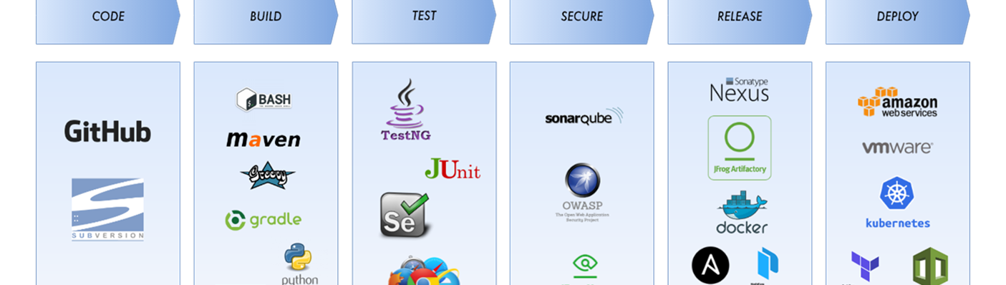
CI/CD
Wiley CI/CD allowed for rapid response to changing conditions
Notes:
CI/CD is one example of this – by enabling small batch sizes we were able to rapidly change our products to meet demands of the pandemic
Wiley has developed standard tools and architecture for our CI/CD pipeline allowing federated teams to manage and own their own deployment pipeliens
In addition we have build a shared CI/CD pipeline which teams can use if they do not want manage their own CI/CD systems
________________
Version control: Tools that track software versions as they are released, whether manually or automatically. This means numbering versions, as well as tracking the configuration and any environmental dependencies that are present, such as the type, brand, and version of the database; the operating system details; and even the type of physical or virtual server that’s needed. This category is related to change management tools.
Build and deploy: Tools that automate the building and deployment of software throughout the DevOps process, including continuous development and continuous integration.
Functional and non-functional testing: Tools that provide automated testing, including best practices listed above. Testing tools should provide integrated unit, performance, and security testing services. The objective should be end-to-end automation.
Provisioning and change management: Tools to provision the platforms needed for deployment of the software, as well as monitor and log any changes occurring to the configuration, the data, or the software. These tools ensure that you can get the system back to a stable state, no matter what occurs.

Slide 18
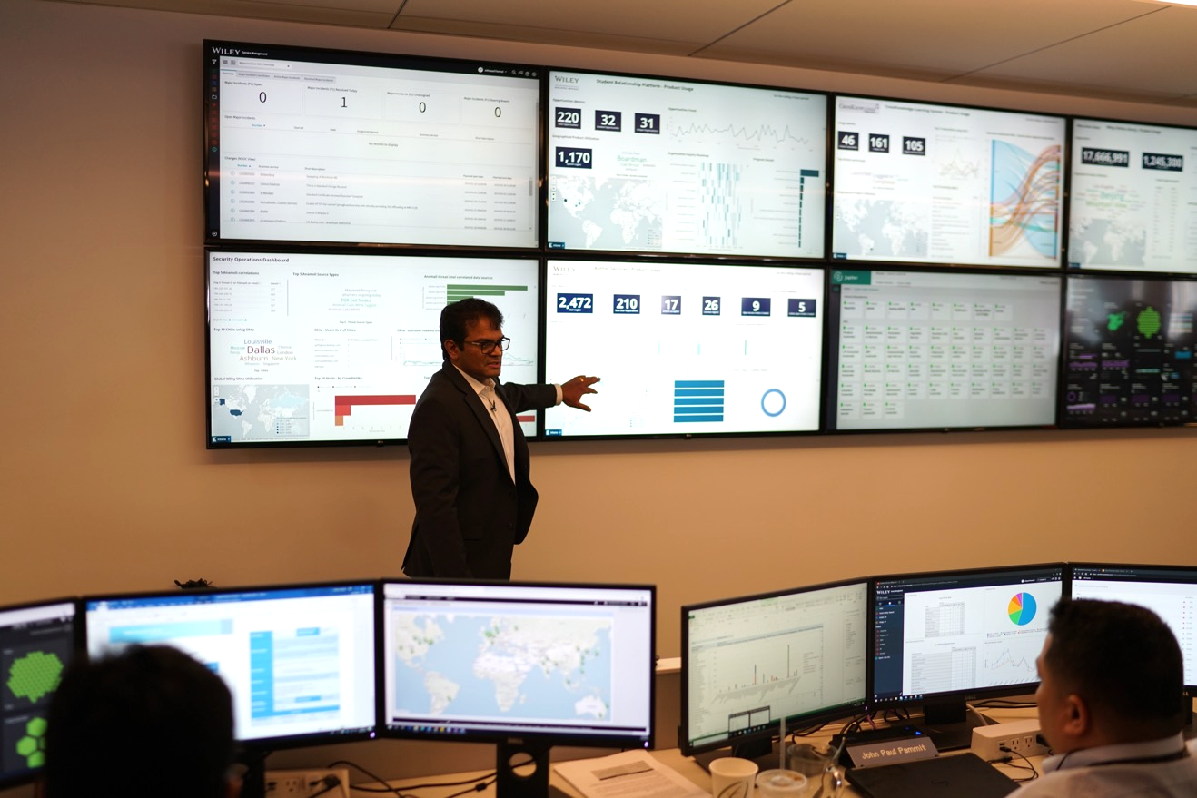
Transparency & Observability
Monitoring enables us to see problems before they occur and resolve issues quicker when they do.
Notes:
Transparency and observability are other key principles that underlie DevOps which are implemented through proper monitoring.
Monitoring enables us to see problems before they occur and resolve issues quicker when they do.
If monitoring is available, shared, and properly configured, it can provide visibility into rapid shifts, which may indicate some sort of crisis has changed.
We must ensure that we are monitoring for significant shifts that are outside of normal cyclical patters. When problems do occur, proper monitoring enables us to quickly determine the source of the problem, allowing us to make rapid adjustments to provide continued service for our customers.
In order to have a culture of transparency there must be shared visibility into the monitoring data.
In order to collaborate, all people within the organization must have visibility into the data that makes the organization run.
At Wiley, we rapidly deployed a Business Continuity (BCP) Dashboard which had a broad range of data extending beyond system level metrics to key business metrics.
These dashboards showed usage of VPN as well as information about number of new registrants on each of our e-learning platforms. The BCP dashboard showed data about how internal collaboration tools were being used so we could optimize our work from home workforce, as well as the number of research articles being submitted by authors around the globe researching this new disease.
By sharing data with our technical teams and our business teams, we used the concept of transparency to truly allow our business to make better decisions in light of a rapidly changing environment during unprecedented times.

Slide 19
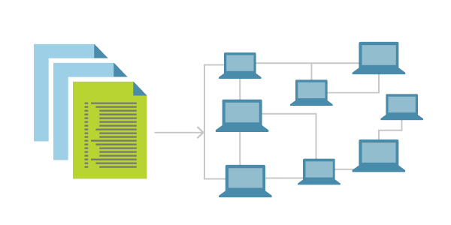
Infrastructure as Code
Notes:
Infrastructure as code (IaC) is another DevOps tool which helped us to adjust to rapidly changing conditions.
IaC allows us to treat infrastructure in a programmatic way by describing it with code.
By including IaC in our deployment pipeline, we can easily and quickly make incremental changes to adjust to changing conditions.
In addition, automatic adjustments through elastic scaling can help us automatically scale up and down our capacity.
When COVID-19 hit and usage spiked on our platforms, this ability to rapidly and elastically scale in response to change is critical to meeting the demand.

Slide 20
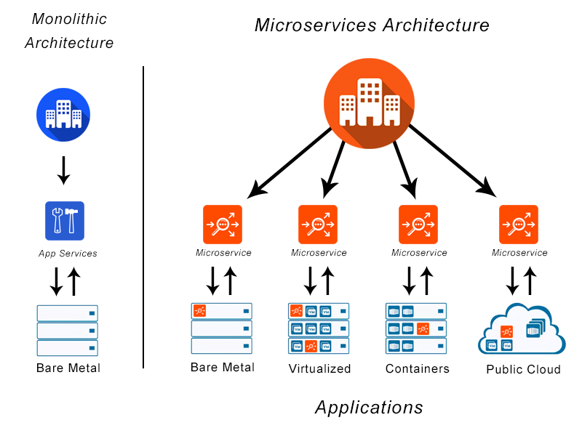
Socially distance your applications
Notes:
Social distancing is keeping people healthy during the pandemic, some appropriate distancing of our application components can help keep our services up and running.
Loosely coupled systems is a good way to accomplish this sort of distancing at a systems level.
Loosely coupled architectures also help provide more resilient systems which can help avoid disaster.
By ensuring that independent components of our system can operate independently, we ensure that one portion of the system failure does not cause complete system failure.
Loosely couple architectures become increasingly important as some of the components and services our applications depend on are SaaS services hosted and managed by others.
With SaaS services we cannot control the availability so we must make sure overall services continue to operate even if SaaS components fail. In addition to “socially distancing” your applications it is important to test system is resilient to component failure.
One great way to do this is through chaos testing at a service level. It is important to ensure that continuous testing looks not only at failure of individual infrastructure components, but also failure of features or functionality within your application.

Slide 21
Responding to Crisis

Slide 22
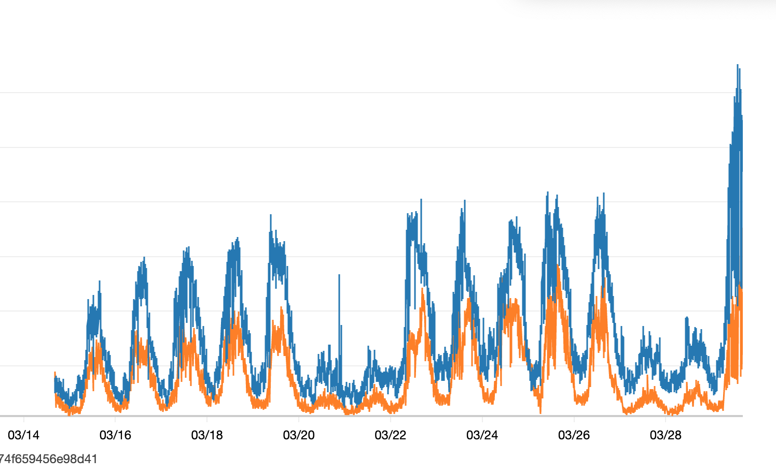
Application traffic spiked in March as companies rapidly transitioned to work from home training programs.
Notes:
The pandemic has impacted many companies in many different ways.
Wiley is a diverse company ranging from research to education.
Many of our markets saw actual saw significant increases due to the pandemic. This was particularly true for our online education platforms
As the global impact of Covid began to escalate in March, Wiley encountered significant increases in platform activity and load levels, and response times started to be impacted.
Activity on a single customer instance dramatically increased (due to aggressive promotion of work from home training to their population) and activated a known issue that started impacting response times for all instances in that hosting region.
The performance degradation occurred due to problems with caching overhead in the application. In order to address the issue, configuration changes were made to limit impact to only the customer instance that was causing the issue.
Once that was completed platform changes were developed and tested to optimize and reduce the caching overhead.
The changes were pushed to production over the course of two days, resolving the problem and improving the overall performance of the platform.

Slide 23
Response times spiked due to additional traffic and known caching problem but drop dramatically after improvements are deployed.
Notes:
This graph shows response time before and after the optimizations were made.
Because of DevOps practices and technologies such as CI/CD, we were able to react quickly to a serious problem by reprioritizing current work and addressing the immediate need, while at the same time reducing our backlog and improving the baseline performance of the platform.
We also saw a reflection of DevOps teams in responsive teams that were engaged and energized by owning and managing the successful response and decision-making process directly.
We were able to rapidly deploy changes to meet the changing demand on our system because we had appropriately developed our CI/CD practices.

Slide 24
Where do we go from here?

Slide 25
What’s next?
The world is transforming, and we must too
Now, more than ever, we are all technology companies
Never has operations and execution been more important
Never has DevOps been more crucial to success
Notes:
This is hard – I do not want to imply otherwise or to make little of the fact that people are suffering.
There are very real impacts to people at a very personal level and to businesses around the globe.
There is business challenging and, even for businesses that are not adversely impacted, running a business during a pandemic is not easy.
In the tech world we are, for the most part, extremely privileged to have jobs that we can do at home or anywhere,
I do not have a crystal ball
The world is transforming and we must too
Never has technology been more important – there has for some time been an understanding that the business needs technology but more and more there is a recognition that technology is the business or, at very least, the business and technology are inseparable
Never has operations and execution been more important
Never has the people, process, and technology of DevOps been more crucial to success
So look towards the key principals of DevOps and the way they are applied to people, process, and technology and think about how you can progress these in your area

Slide 26
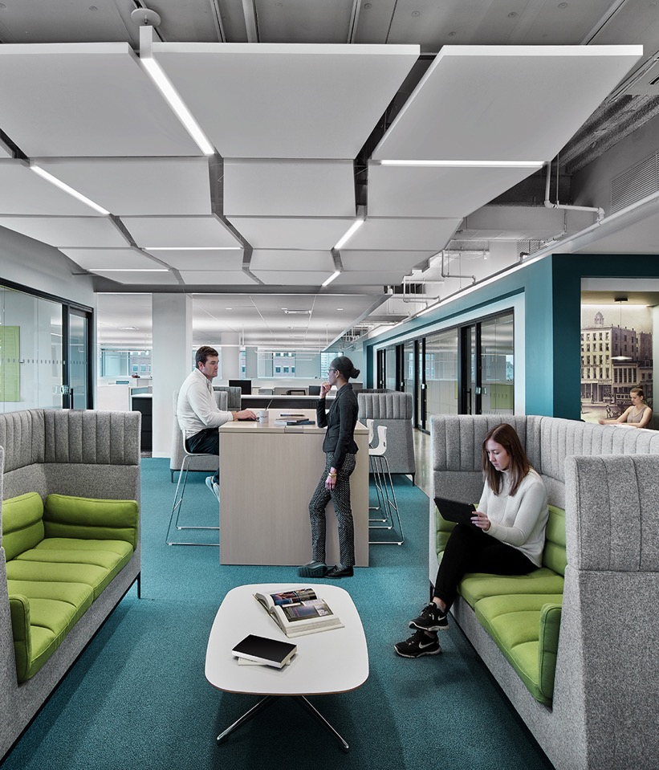
What’s next?
Future of Collaboration
Even after a vaccine, many companies may never return to offices as they were
In remote-first companies
Meeting hubs, not offices
Dedicated desks will be a thing of the past
Offices become meeting hubs where people come together to solve difficult problems
Notes:
If this presentation has relayed anything I hope it has relayed that high performing DevOps teams are centered around collaboration
While we may not be physically together we must continue to find ways to collaborate and build community
At Wiley we will not return to office as normal anytime soon in US
Opportunity to re-envision what an office is used for
At Wiley we see productivity on the rise – why would we spend money on realestate in NY when we can spend it building better products for research and education and reduce the cost of bringing education to people around the world
It is possible, just possible, that offices of the future will be meeting places more than sitting places
Why come to the office to sit alone at a desk
Perhaps the office of the future will be a set of conference rooms where you come to collaborate

Slide 27

Next Steps
Do not wait for a “return to normal”
Find new opportunities and accelerate
Re-envision your business
Notes:
While responding to crisis is tough there are invariably opportunities - find the opportunity
The hope that we will 'return to normal' may be detrimental to move forward. Stop waiting, embrace constant change.
There is not a “back to normal” there is just the next normal, and the next one after that, and a next one after that.
If you are waiting for a return to normal you may be waiting while you go out of business.
Continue to drive forward, continue to innovate, continue to transform. Because, while we may never get back to normal, there is tremendous opportunity in the next change, and it is up to you to take advantage of it.

Slide 28
Next Steps
Read more: medium.com/@seandmacknyc
Join Wiley team: wiley.com/careers
Connect with me on LinkedIn: in/SeanDMack
Continue the discussion on Twitter @SeanDMackNYC
Notes:
Join Wiley team: wiley.com/careers
Connect with me on LinkedIn: in/SeanDMack
Continue the discussion on Twitter @SeanDMackNYC

Slide 29


Q&A
@SeanDMackNYC
in/seandmack/

Slide 30
Appendix

Slide 31
Really it should be BusProdDevTestSecOps
Notes:
https://devops.com/surprise-broad-agreement-on-the-definition-of-devops/
“No, no it really should be Dev_____Ops” where the blank is filled in by their own specialty. Examples: DevQAOps, DevOpsSec, DevSecOps, BizDevOps and of course

Slide 32
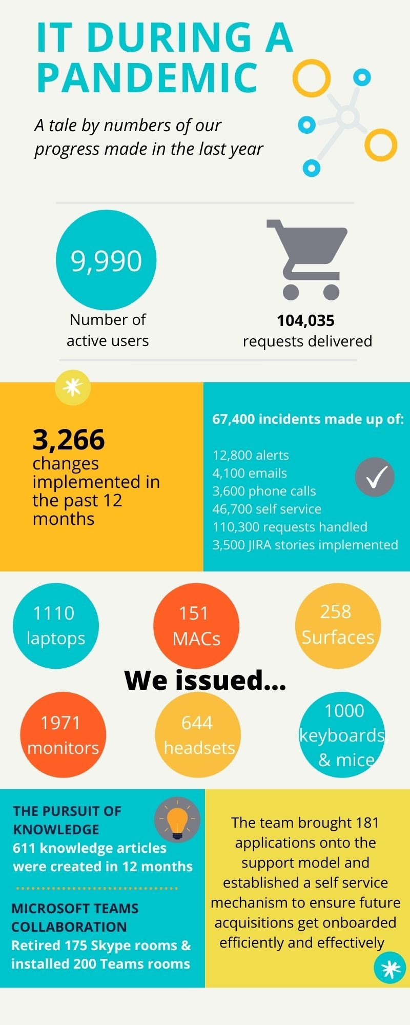

Slide 33
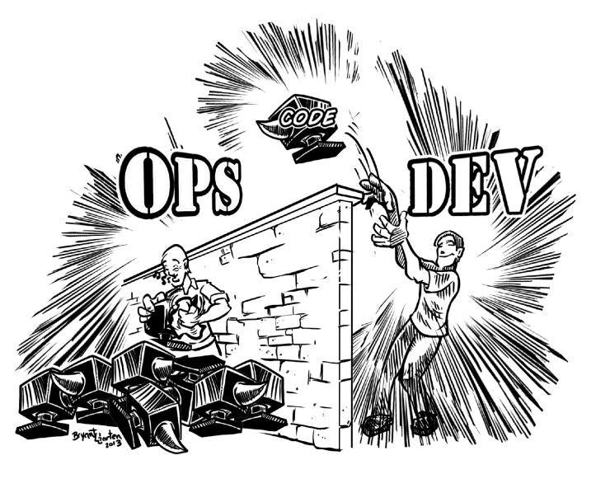
Notes:
DevOps as an anti-pattern

Slide 34
The DevOps Advantage
The goal of DevOps is to make improvements across all components in product and service delivery.
Improved deployment frequency
Faster time to market
Lower failure rates of new releases
Faster recovery time

Slide 35
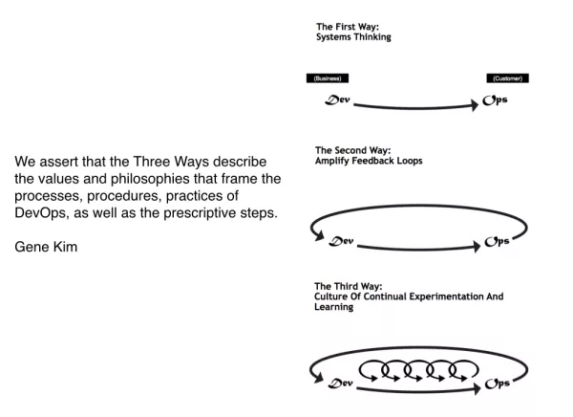
Notes:
The First Way emphasizes the performance of the entire system, as opposed to the performance of a specific silo of work or department — this as can be as large a division (e.g., Development or IT Operations) or as small as an individual contributor (e.g., a developer, system administrator).
The focus is on all business value streams that are enabled by IT. In other words, it begins when requirements are identified (e.g., by the business or IT), are built in Development, and then transitioned into IT Operations, where the value is then delivered to the customer as a form of a service.
The outcomes of putting the First Way into practice include never passing a known defect to downstream work centers, never allowing local optimization to create global degradation, always seeking to increase flow, and always seeking to achieve profound understanding of the system (as per Deming).
Andon chords
Shared goals
Value stream analysis
Cycle time - time to value
Automated test
The Second Way is about creating the right to left feedback loops. The goal of almost any process improvement initiative is to shorten and amplify feedback loops so necessary corrections can be continually made.
The outcomes of the Second Way include understanding and responding to all customers, internal and external, shortening and amplifying all feedback loops, and embedding knowledge where we need it.
A/B testing
Feature flags
Swarming issues
Customer contacts
The Third Way is about creating a culture that fosters two things: continual experimentation, taking risks and learning from failure; and understanding that repetition and practice is the prerequisite to mastery.
We need both of these equally. Experimentation and taking risks are what ensures that we keep pushing to improve, even if it means going deeper into the danger zone than we’ve ever gone. And we need mastery of the skills that can help us retreat out of the danger zone when we’ve gone too far.
The outcomes of the Third Way include allocating time for the improvement of daily work, creating rituals that reward the team for taking risks, and introducing faults into the system to increase resilience.
Chaos engineering
Not just fault tolerant - but fault appreciative :)
20% time
Hackathons
Blameless culture/blameless postmortems
From DevOps Institute
The First Way – Flow
• Practices include (but are not limited to):
• Continuous integration – a development practice that requires developers to integrate code into a shared repository on a daily basis
• Continuous delivery – a methodology that focuses on making sure software is always in a releasable state throughout its lifecycle
• Continuous deployment – a set of practices that enable every change that passes automated tests to be automatically deployed to production © DevOps Institute unless otherwise stated
Copyrighted Materials.
• Value stream mapping – a lean tool that depicts the flow of information, materials and work across functional silos with an emphasis on quantifying waste, including time and quality
• Kanban – a method of work that pulls the flow of work through a process at a manageable pace
• Theory of constraints – a methodology for identifying the most important limiting factor (i.e., constraint) that stands in the way of achieving a goal and then systematically improving that constraint until it is no longer the limiting factor
The Second Way – Feedback
Practices include (but are not limited to):
• Automated testing
• Peer review of production changes
• Monitoring/Event Management data
• Dashboards
• Production logs
• Process measurements
• Post-mortems
• Shared on-call rotation
• Change, Incident, Problem and Knowledge Management data
The Third Way – Continuous experimentation and learning
Practices include (but are not limited to):
• Experimentation and learning
• The Deming Cycle
• The Improvement Kata
• Using failure to improve resiliency (e.g., the ‘Simian Army’ concept first adopted by Netflix)
• ITSM improvement practices

Slide 36
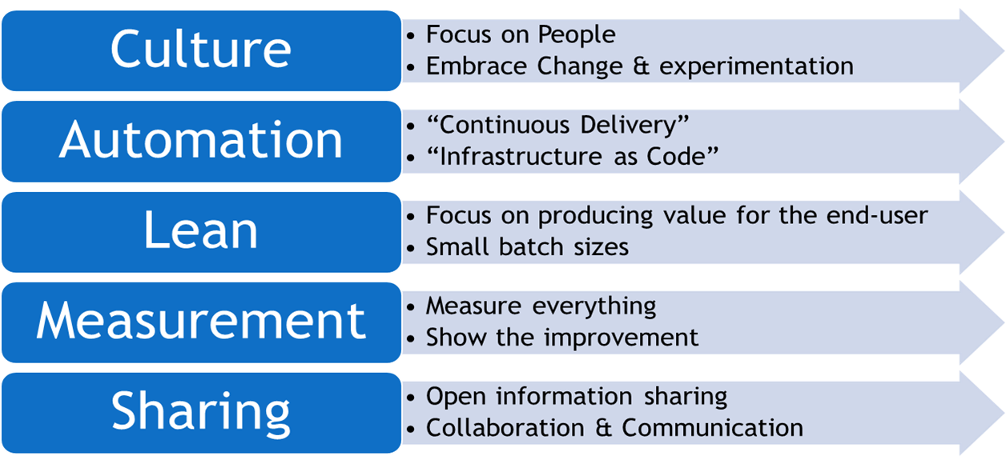

Slide 37
Responding to Crisis
Accelerated VDI migration from datacenter to cloud
Accelerated file share migration from datacenter to cloud
Remote imaging – Automated machine imaging utilizing InTune eliminates the need for on-site office imaging of hardware
Process take 40 minutes vs. 4-hour manual process
Equipment is shipped direct to colleagues’ home with no in person contact
Accelerated transition to lower cost support channels
Notes:
Getting done in two weeks projects that have been in the works for two years
Example of remote imaging for new laptops
Change in user behavior – finally calling into the Service Desk

Slide 38
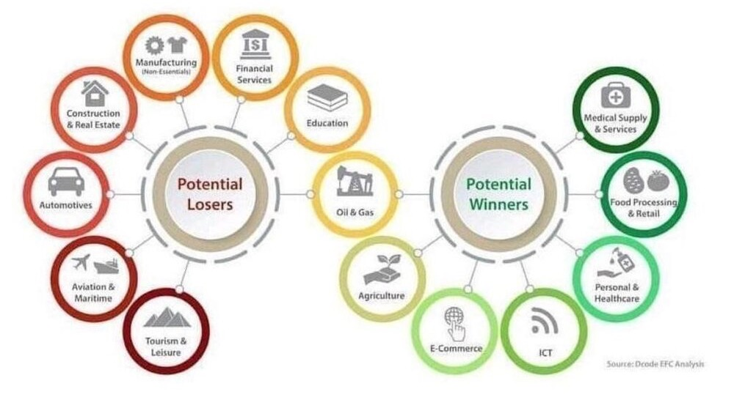
Accelerating Business Transformation
Notes:
Question: what has impact been to your industry/business and what are your doing to adjust?
Impact has varied dramatically by industry
Constant reminder that we are in the fortunate position to
A) Be able to do most of what we do from home
B) Most of the markets we are in have a positive impact (notable education and research

Slide 39
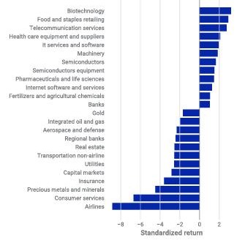
Accelerating Business Transformation
Notes:
The market reaction at the start of the pandemic provides another view into the impact by industry
We have seen vast variance of impact by market segment with significant negative impact to industries like travel
Very positive impacts to industries like grocery and software that assists in remote working - Zoom seeing usage increase by 30x growing from 10 million daily meeting participants in December to over 300 million in April.
https://www.theverge.com/2020/4/23/21232401/zoom-300-million-users-growth-coronavirus-pandemic-security-privacy-concerns-response

Slide 40
Accelerating Business Transformation
“Never let a good crisis go to waste.”
Notes:
However I would posit that there is opportunity in this pandemic for almost all industries – even if that opportunity is drive cost efficiency across business
There’s an old adage that you should “Never let a good crisis go to waste.” and that has never been more pertinent than today
“Never waste a pandemic.” – Chif Umejei, Vice President Information Technology at New York-Presbyterian Hospital
Smashing sacred cows – one every two year, now one every two weeks
Driving platform rationalization forward

Slide 41
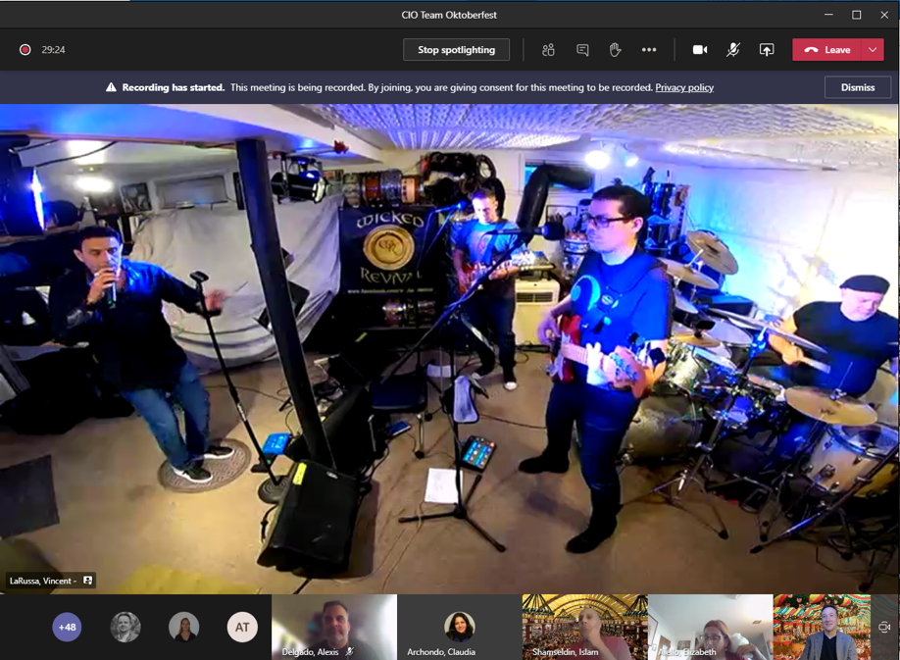


Staying Connected
Notes:
While we are physically further apart, we can connect with our co-workers in new ways.
As much as social distancing makes connecting more difficult, it has also brought us into each other’s homes.
We get to meet our colleague’s families via small cameos when the kid jumps up on their parent’s lap.
Those who were previously reticent to participate in chat platforms and video conferences are jumping on these platforms in astounding rates. This new-found focus on video and chat collaboration is especially useful for geographically diverse teams where on-site meetings and conversations so often inadvertently exclude remote workers.
By forcing us all to work remotely it has truly leveled the playing field and made us all better remote workers.

Slide 42

Silver Linings
Notes:
But the silver-linings are much deeper than reducing commute time and improved use of our collaboration tools.
On an individual level, we have been able to spend more time with family. For me, personally, I can say that for the first time in my career, I have had the opportunity to have dinner with my family almost every night. Between the lack of travel and lack of late nights at the offices, I have been involved in my child’s life in a way I never imagined possible.
On a much broader, global level, we have seen dramatic decreases in CO2 emissions. We have seen improvement in air quality, clean beaches, and environmental noise reduction.
And, while these decreases may be temporary, it makes it evident that we can make an impact. As much as we all hope this will end, as much as we all hope we will see an economic recovery, and a recovery for the people who are sick and suffering from this virus, there are many lessons and many benefits that I hope that we can take with us as we build a new future.

Slide 43


Accelerating Business Transformation
Notes:
Martial arts studio that started offering classes online
* Brazilling Jiu Jitsu Clark Gracie from California - one of the founders of Gracie Jiu-Jitsu, Pan American black belt champion in the middleweight division
* David Leduc World Lethwei Champion
* Frank Shamrock - the first UFC Middleweight Championship
Industry steeped in in-person education now embracing remote learning

Slide 44
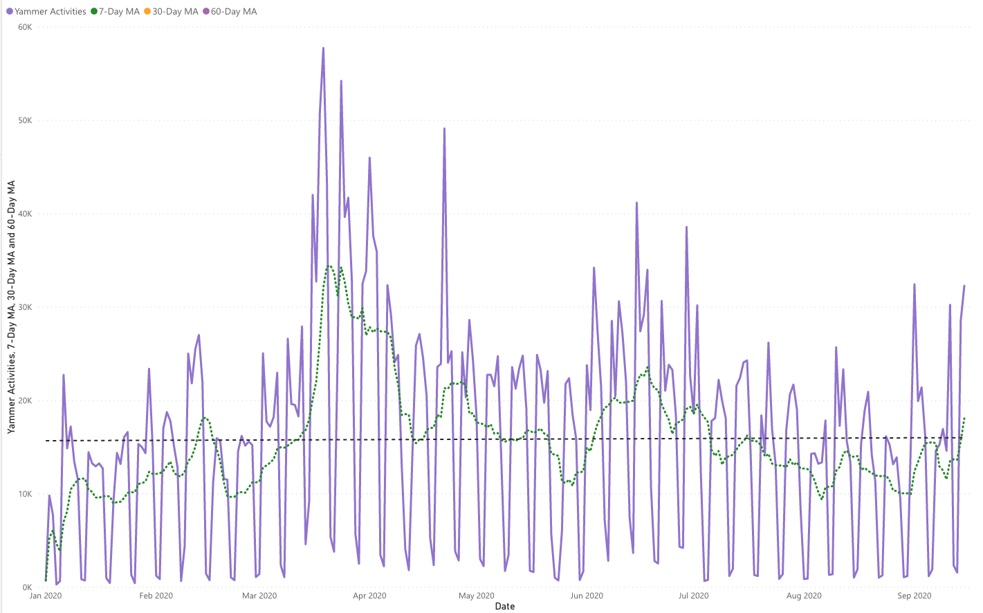
Yammer YTD Activity
30% increase of average daily activity after work from home
Monday, 3/16/20
Wiley begins work from home on global scale.
Notes:
Skype saw a similar boost in usage immediately after shifting to work from home driving global communications to all our resources and offering community building outside of the office
While initial levels subsided we have seen a 30% increase overall and we remain one of the companies with highest performing Yammer networks anywhere

Slide 45
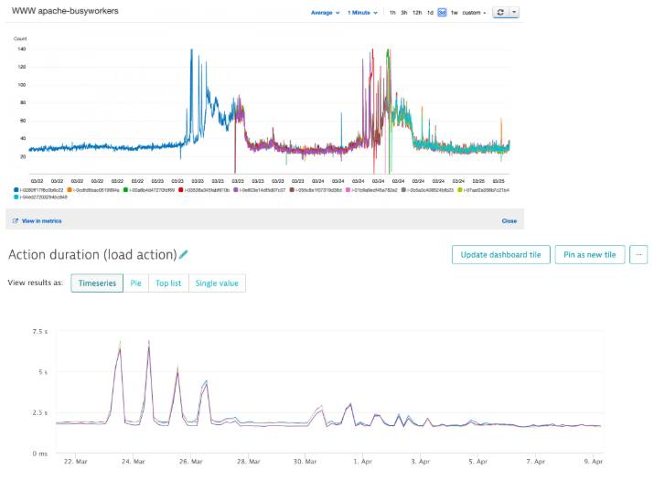
Notes:
March 23rd, AWS Frankfurt infrastructure has been facing huge increase of Apache usage and response time was increasing drastically in an erratic way.
CloudWatch & Dynatrace were already feeling the storm coming and warning us.

Slide 46
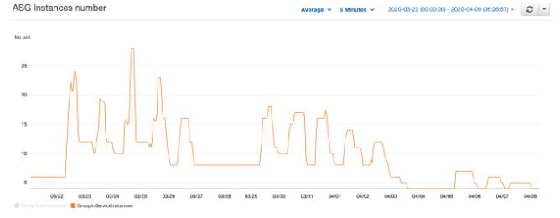
Notes:
The number of web/application servers required to handle the load reached some unusual values.

Slide 47
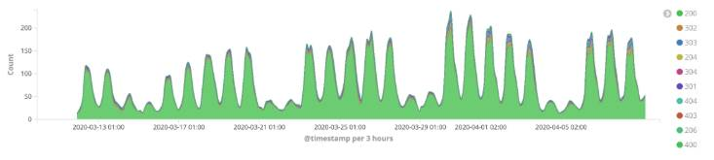
Notes:
The overall activity in Europe was indeed growing. (number of requests x1000)

Slide 48
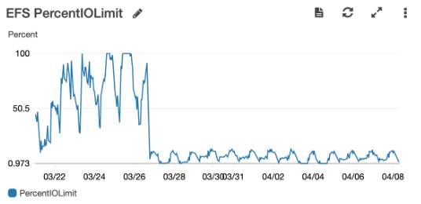
Notes:
We started to dig into Kibana & Dynatrace to understand what was the size of the problem.
Obvious initial suspect : a specific customer platform, generating a lot of traffic but non correlating traffic with the size of detected issues on infrastructure. 30% of the infrastructure read/write HTTP calls were generated by this platform.
-> According to the severity of the situation, the "suspect" has been isolated on a dedicated RDS MYSQL8 and dedicated front servers
As the situation was not improving, (many errors, heavy load on Apache workers, and still affecting performance of all other platforms on AWS FF), focus shifted to shared service causing this.
-> Technical teams, with agreement of the customer, set the Suspect into "maintenance mode"
Focus on a shared service: Redis or any hidden cache?
-> Technical teams set up a dedicated Redis server for the Suspect and decided to put it back live. In // of that, AWS support team has been consulted to get advices on cluster configuration adjustments. Those have been successfully implemented.
After all this, the rest of the infrastructure was still suffering from abnormal response time peaks.
-> Technical teams decided to deliver EFS enhancements that were in our backlog. Also switched to Application Load Balancer (instead of ELB)
EFS was doing better, peaks are getting spaced in time but they are still here.
This is time to work on the application level (while still working on the IT side).
As these issues have an impact on our learners, and usage of CKLS platform is continuously increasing (due to Covid-19 work from home situation), a plan has been set up, in agreement with our product team, for the next sprint or so:
Delay the March end of month release delivery, including a package of new features, to not further impact performance and noise the logs or root cause analysis
Assign 2 senior developers to the maintenance team for a sprint, to solve a number of optimizations pending in CKLS backlog
Assign a full Squad (4 devs, 1 QE) for 1 sprint to Techno enhancements
Organize a daily delivery of hot fixes to production to be able to observe impact of each modification done
Reschedule the end of month delivery by small packages
Stabilize the production, catch up on delay, get back to normal
Technical teams decided to deliver each day something “ helping the production". In total we have delivered 11 releases in a row with around 15 fixes (stories / incidents) in order to remove millions of "useless calls" on production servers and reduce the load. We also :
- Added robustness on the most used end points (according to Dynatrace)
- Adjusted any timeouts we could find, lowered Timeout conditions
- File system management has been optimized as any other cache mechanisms like OpCache.
- Optimized (do not load) the fill framework in source file, site file)
- Switched to random suggestion mode on our Big Data engine to reduce loading on API server
- Optimized opcache and included configuration files in memory cache to avoid reading config files from EFS
- Removed Mobile application "useless" calls on CKLS code (PHP session, webservice ping)
- Upscaled the Redis server and upgraded the Redis engine to latest version.
We were doing way better than before but technical teams still think that we are not done yet.
IT infrastructure team also worked on MySQL tweaking and decided to modify the query_cache_size parameter now that the response time is under a sec for the past week.
This last action seems to settle the overall situation and this sum of improvements had made us able to run EU FF with 6 front servers minimum against 20 minimum the past months. We are closely monitoring all this.
This was a huge collaborative work from many teams : IT/DEV/QE/Tech Managers/Support/Product. This will deserve a dedicated celebration according to me 😉

